Slide 1
Deep Sequence Models for Search Ranking - Session II
Tutorial Link: https://dlranking.github.io/dlrr/
Data source: https://huggingface.co/datasets/xglue
XGLUE: A New Benchmark Dataset for Cross-lingual Pre-training, Understanding and Generation)
Presenters: Moumita Bhattacharya, Abby Liu, Linsey Pang
Notebooks: Abby Liu, Linsey Pang
Date: August 14th, 2022
Notes:
Hello all, very excited to have you all here at our tutorial on Deep Search Relevance Ranking in Practice

Slide 2
Agenda
Brief History of Deep Learning Models For Search Ranking
Sequence Models
RNN, LSTM
Attention, Self Attention
Transformer Architecture
Deep Classifier
Deep Siamese Network
Hands-on Session

Slide 3
Brief History of Deep Neural Network For Search Ranking

Slide 4
Key responsibilities of a search engine
Indexing — Ingesting and storing data efficiently so that it can be retrieved quickly
Querying — Providing retrieval functionality so that search can be performed by an end user
Ranking — Presenting and ranking the results according to certain metrics to best satisfy users’ information needs
Notes:
Given a query and a set of candidate documents, a scoring function is usually utilized to determine the relevance degree of a document with respect to the query. Then a ranking list is produced by sorting in descending order of the relevance score.

Slide 5
Neural IR
Providing a representation of textual data that captures word and document semantics, allowing a machine to say which words and documents are semantically similar
Under certain assumptions, approximating any function. There’s theoretically no limit to the kinds of tasks deep neural networks can achieve
Notes:
The term neural search first appeared during a research workshop at the SIGIR 2016 conference (www.microsoft.com/en-us/research/event/neuir2016) focused on applying deep neural networks to the field of information retrieval.

Slide 6
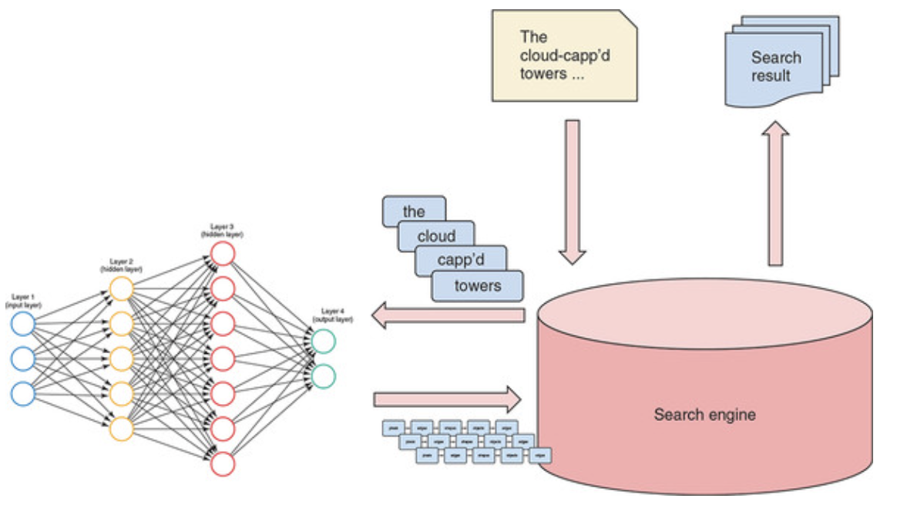
Deep Classifier
Ref: (link)
Notes:
Relevance ranking is a core problem of information retrieval. Given a query and a set of candidate documents, a scoring function is usually utilized to determine the relevance degree of a document with respect to the query. Then a ranking list is produced by sorting in descending order of the relevance score.

Slide 7
Brief History of Neural IR
Neural IR resort to deep learning for tackling the feature engineering problem of learning to rank, by directly using only automatically learned features from raw text of query and document. 
There have been some pioneer work, including DSSM [ref], and CDSSM [ref].
Both DSSM and CDSSM directly apply deep neural networks to obtain the semantic representations of query and document, and the ranking score is produced by computing their cosine similarity.
Studies such as DRMM [ref] and DeepRank [ref] argued that DSSM and CDSSM only consider the semantic matching between query and document, but ignored relevance matching as well as modeling the relevance generation process.

Slide 8
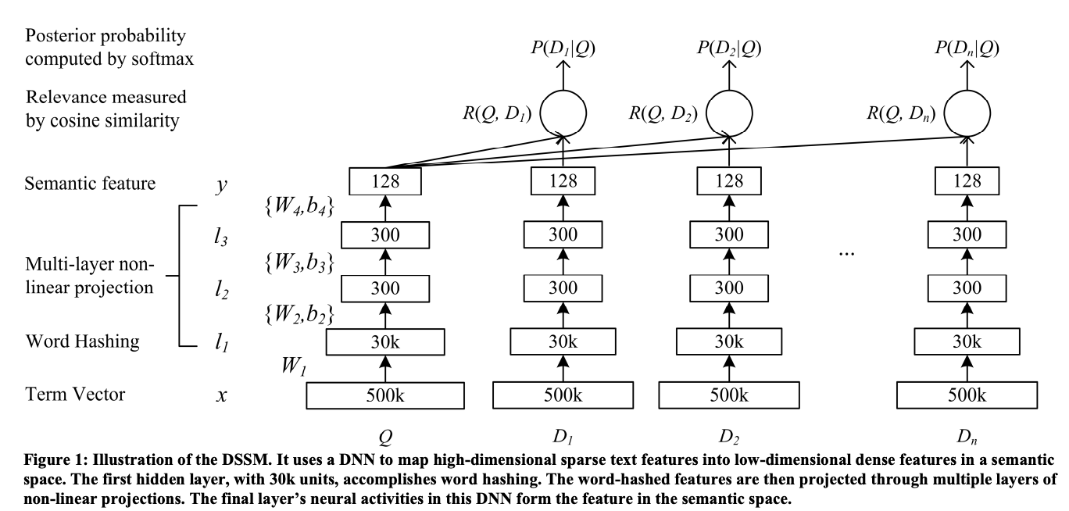
Learning Deep Structured Semantic Models
for Web Search using Clickthrough Data (DSMM: 2013)

Slide 9
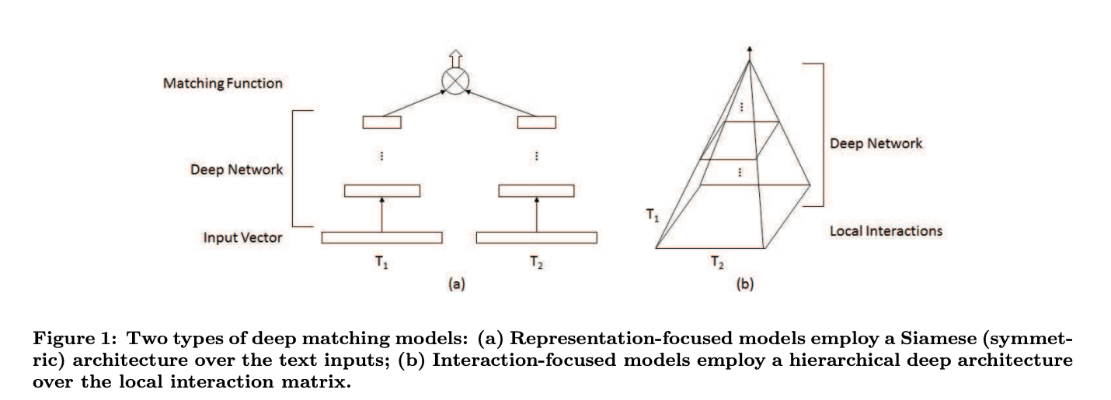
A Deep Relevance Matching Model for Ad-hoc Retrieval (DRMM: 2017)
(Ref: link)

Slide 10
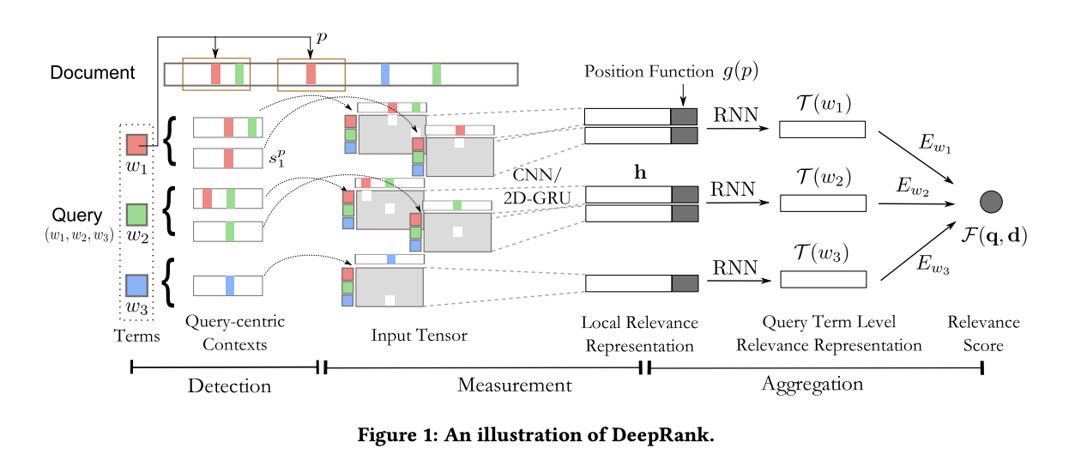
DeepRank: A New Deep Architecture for Relevance Ranking in Information Retrieval (2019)
Ref: (link)

Slide 11
Sequence Models
RNN
GRU
LSTM
Attention
Transformer

Slide 12
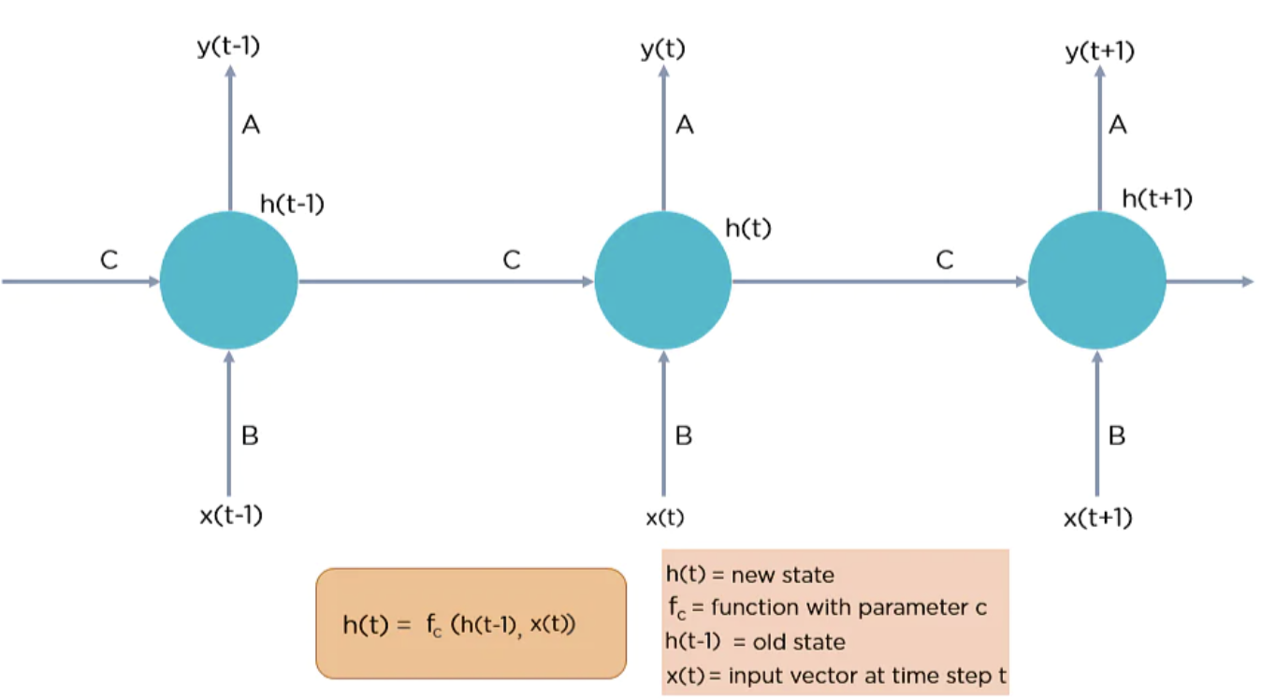
Recurrent Neural Network
torch.nn.RNN(input_size, hidden_layer, num_layer, bias=True, batch_first=False, dropout = 0, bidirectional = False)

Slide 13
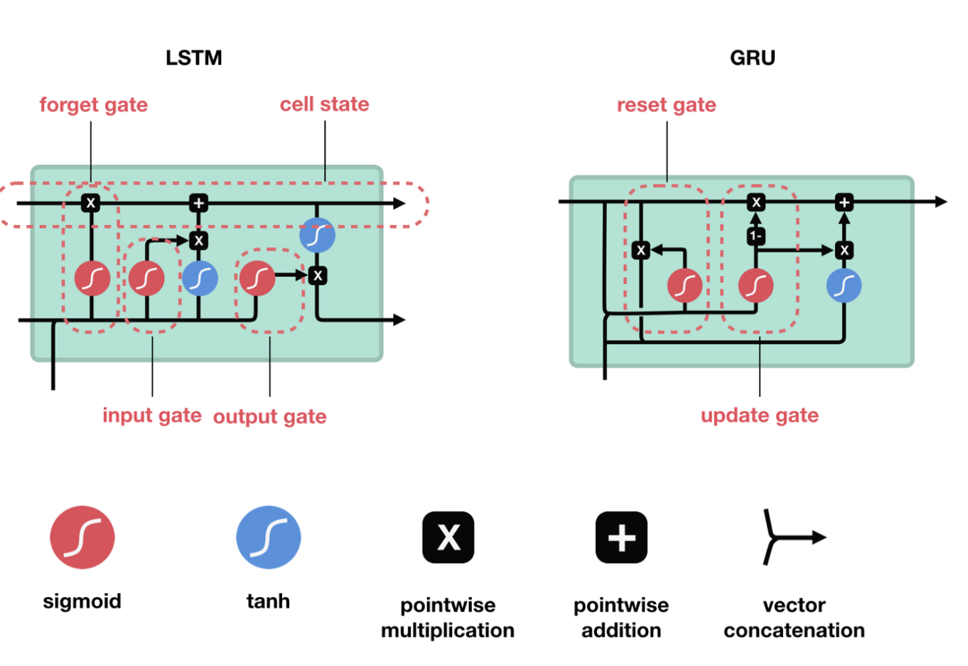
GRU and LSTM
Ref: blog

Slide 14
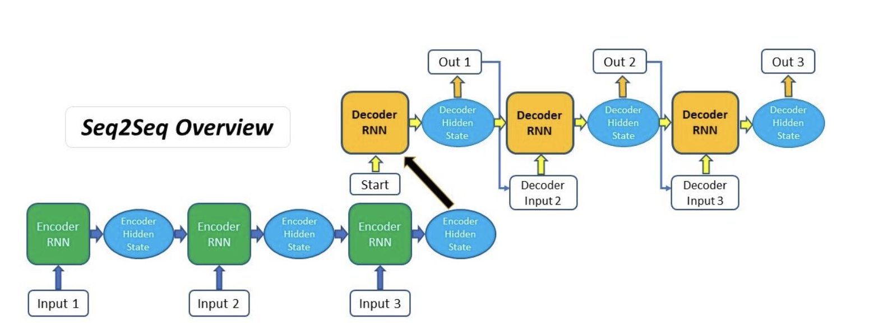
Encoder and Decoder for Seq2Seq

Slide 15
Attention and Self Attention

Slide 16
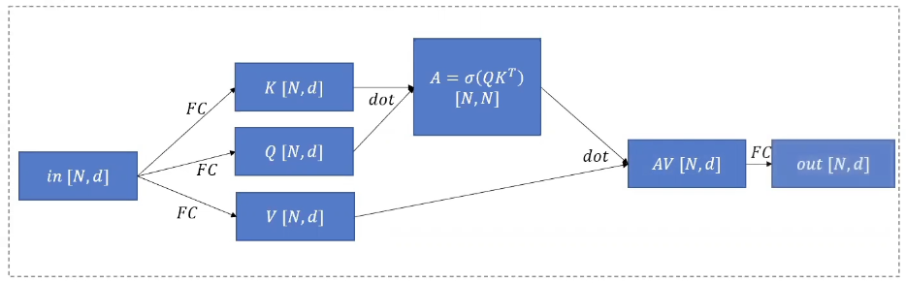
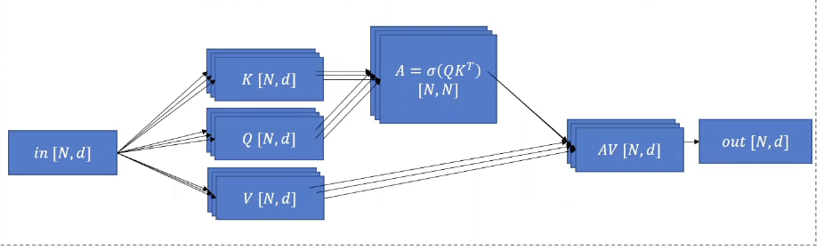
Single and Multi-Head Attention
Notes:
Before that just a quick reminder of simple self attention. For simple self attention we have in the input an N on d metrics. This is projected to keys, query and values each one using a fully connected layer. Then the keys and queries are multiples (dot product) together and applied to a softmax in order to receive a score for each item over each item. Then those are multiplied with the values to receive a final representation for each item and then projected back to the original dimension of N on d matric with a FC layer. This can be done multiple times to get multi-head attention.

Slide 17
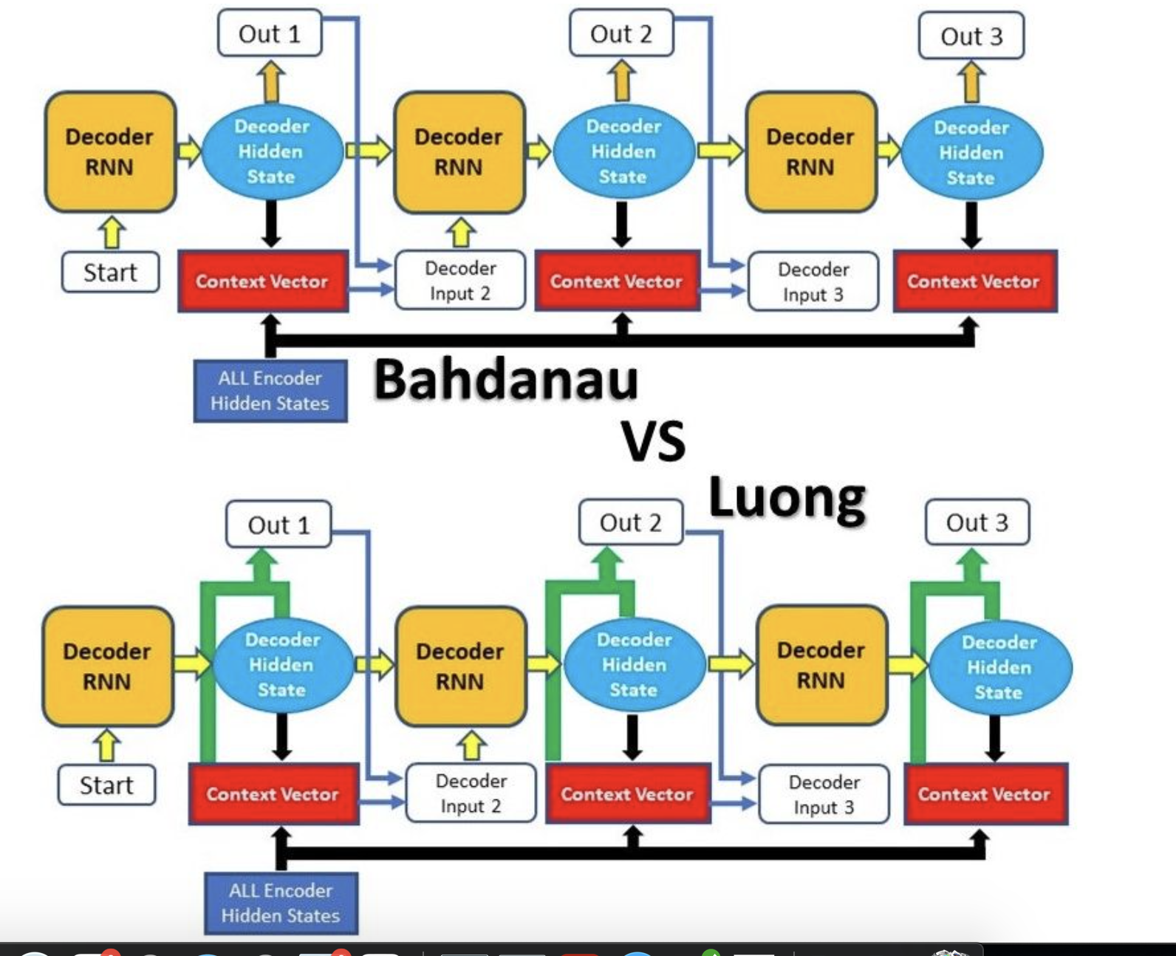
Types of Attentions (Bahdanau vs Luong)

Slide 18
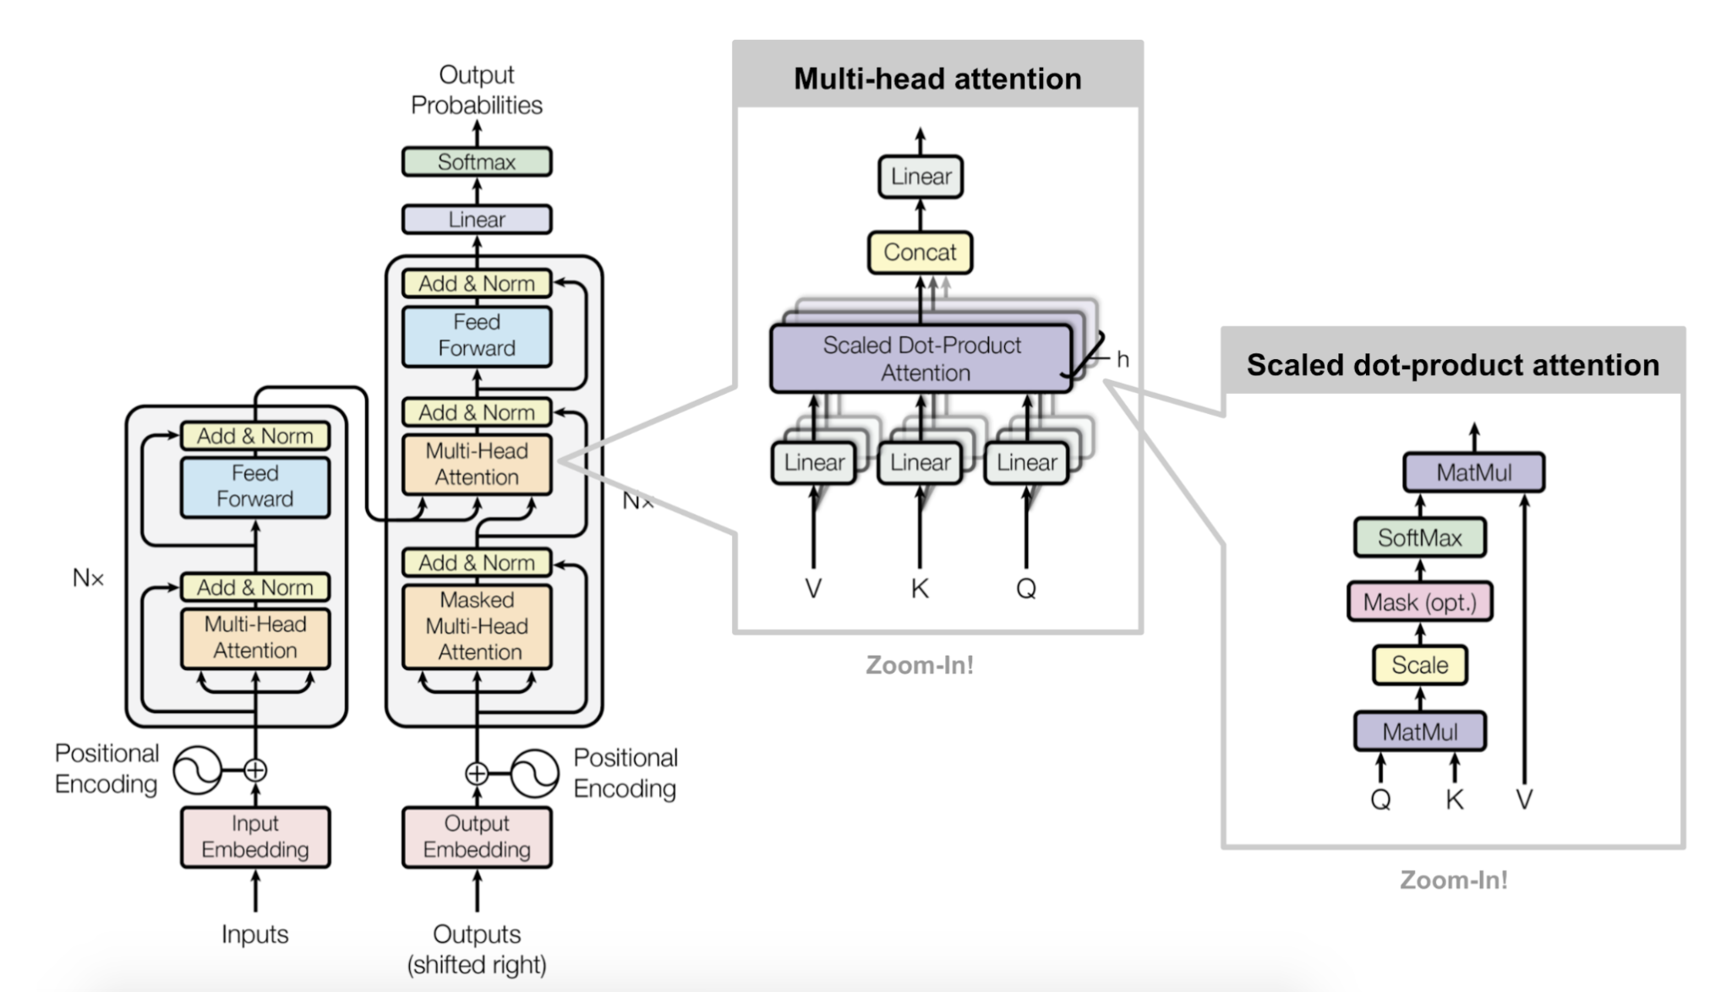
Transformer

Slide 19
XGLUE dataset

Slide 20
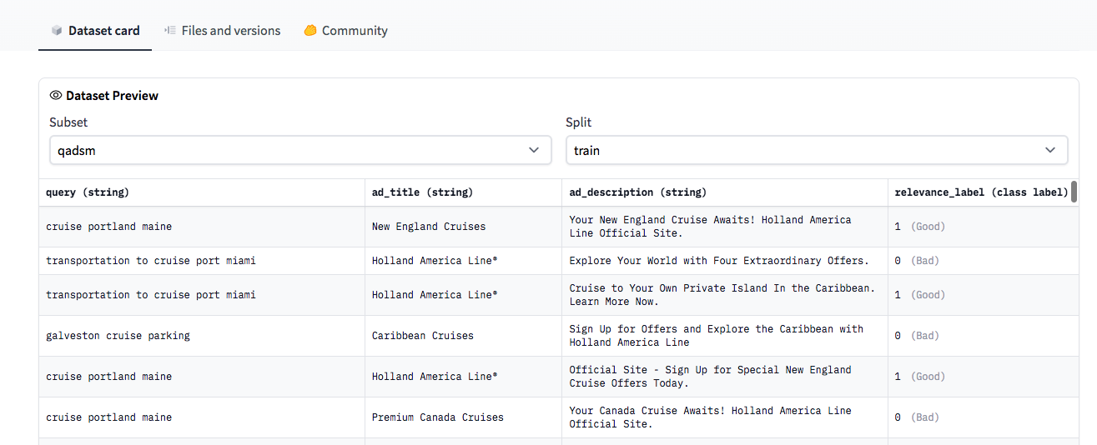
XGLUE - QADSM dataset
QADSM: Microsoft Query-Ad Matching dataset

Slide 21
XGLUE - QADSM dataset
Dataset size:
Train | train | (100000, 4)
Validation | validation.en | (10000, 4)
 | validation.de | (10000, 4)
 | validation.fr | (10000, 4)
test | test.en | (10000, 4)
 | test.de | (10000, 4)
 | test.fr | (10000, 4)

Slide 22
Deep Classifier Network

Slide 23
Deep Classifier Network
The goal is to rank the documents based on the query document similarity.
Use the BERT model to generate the embeddings of the queries and embeddings of the documents that capture the semantic meanings of them from the text.
Concatenate the query and document embeddings, and feed into a classification network to calculate the probability of the document related to the query
Rank the documents based on their probability score to the query

Slide 24
Deep Classifier Network
Probability Score
MLP
…
…
C
T1
T 2
T N
T[SEP]
T 1
T2
TN
BERT
…
…
E[CLS]
E1
E 2
E N
E[SEP]
E 1
E2
E N
…
…
[CLS]
Tok 1
Tok 2
Tok N
[SEP]
Tok 1
Tok 2
Tok N
Query
Document

Slide 25
Deep Classifier Network
Colab Demo

Slide 26
Deep Siamese Network

Slide 27
Deep Metric Learning
The goal is to capture similarity between embeddings, such that the projected distance of similar items in the embedding space is smaller than the dissimilar items.
Compared to the standard distance metric learning, it uses deep neural networks to learn a nonlinear mapping to the embedding space
Helps with extreme classification settings with huge number classes, not many examples per class

Slide 28
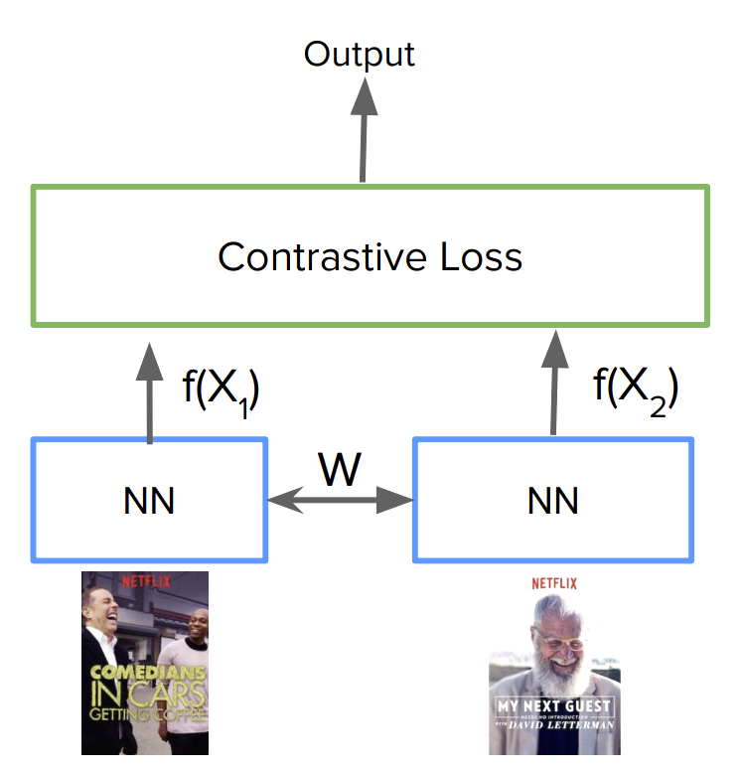
Siamese Networks
Left and right legs of the network have identical structures (siamese)
Weights are shared between the siamese networks during training
Networks are optimized with a loss function, such as contrastive loss

Slide 29
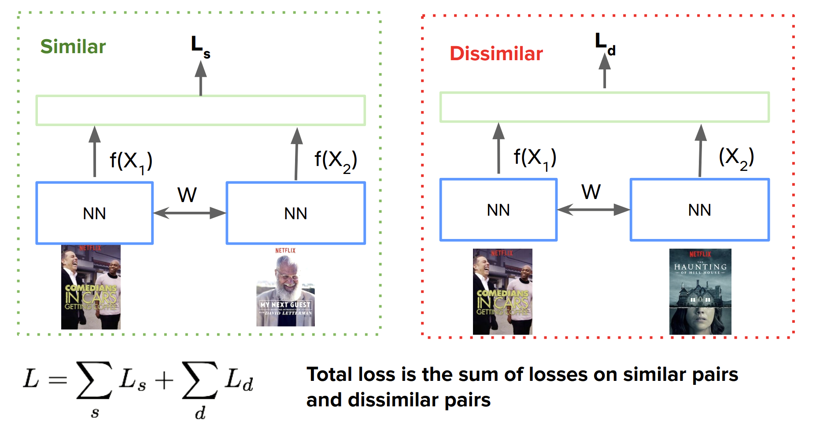
Siamese Networks

Slide 30
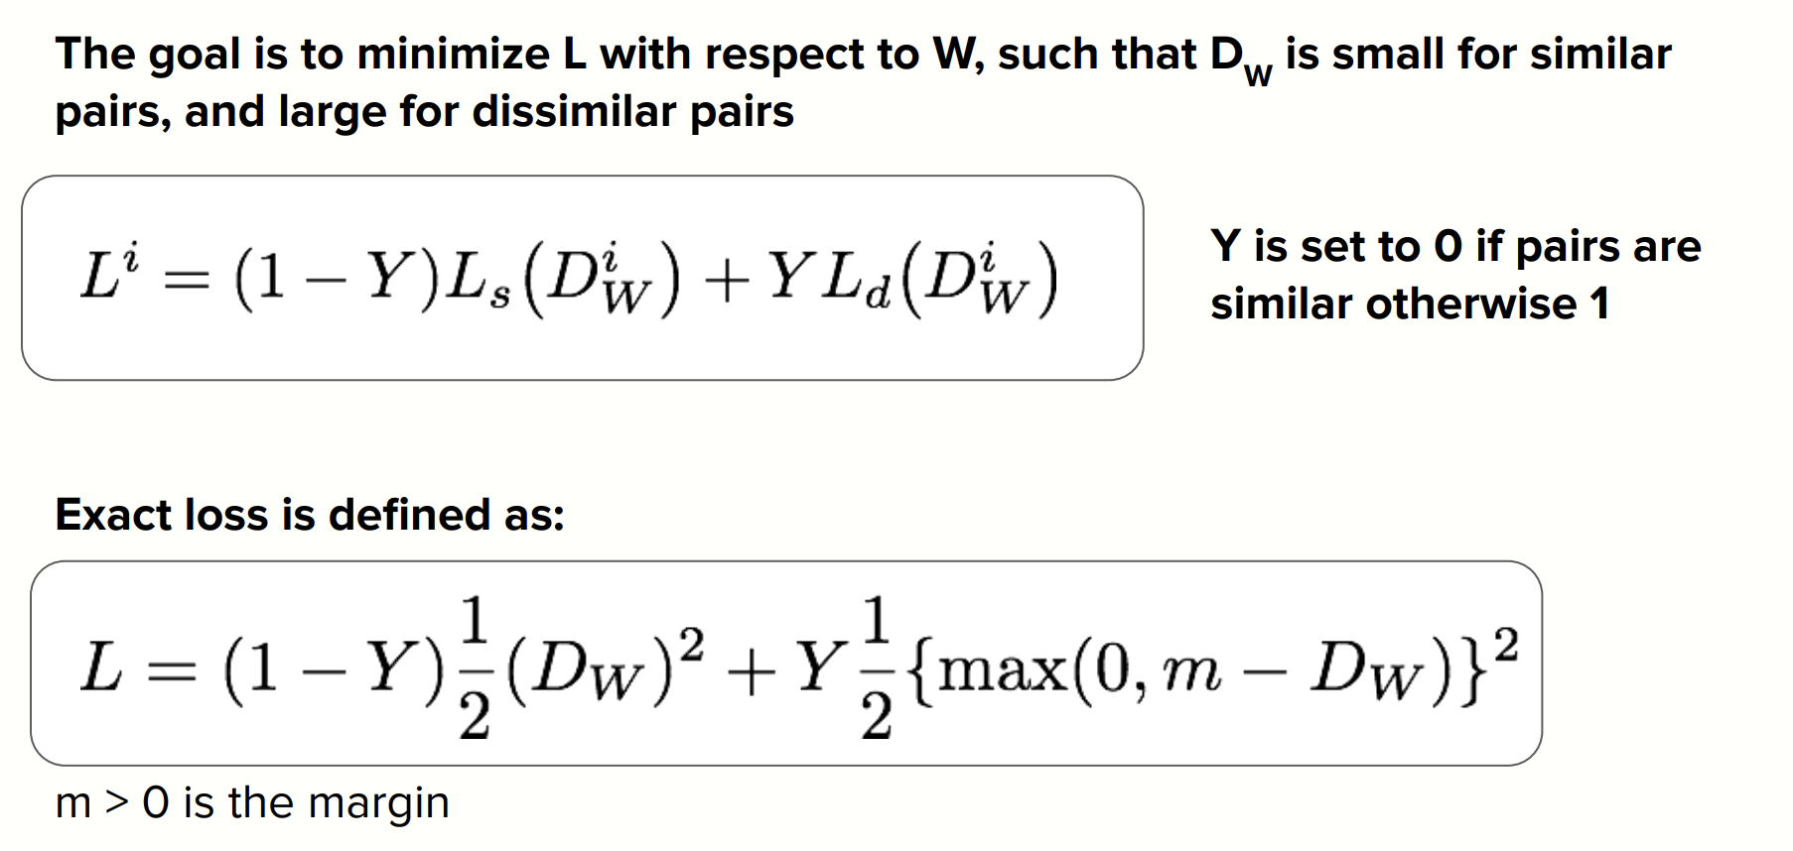
Contrastive Loss

Slide 31
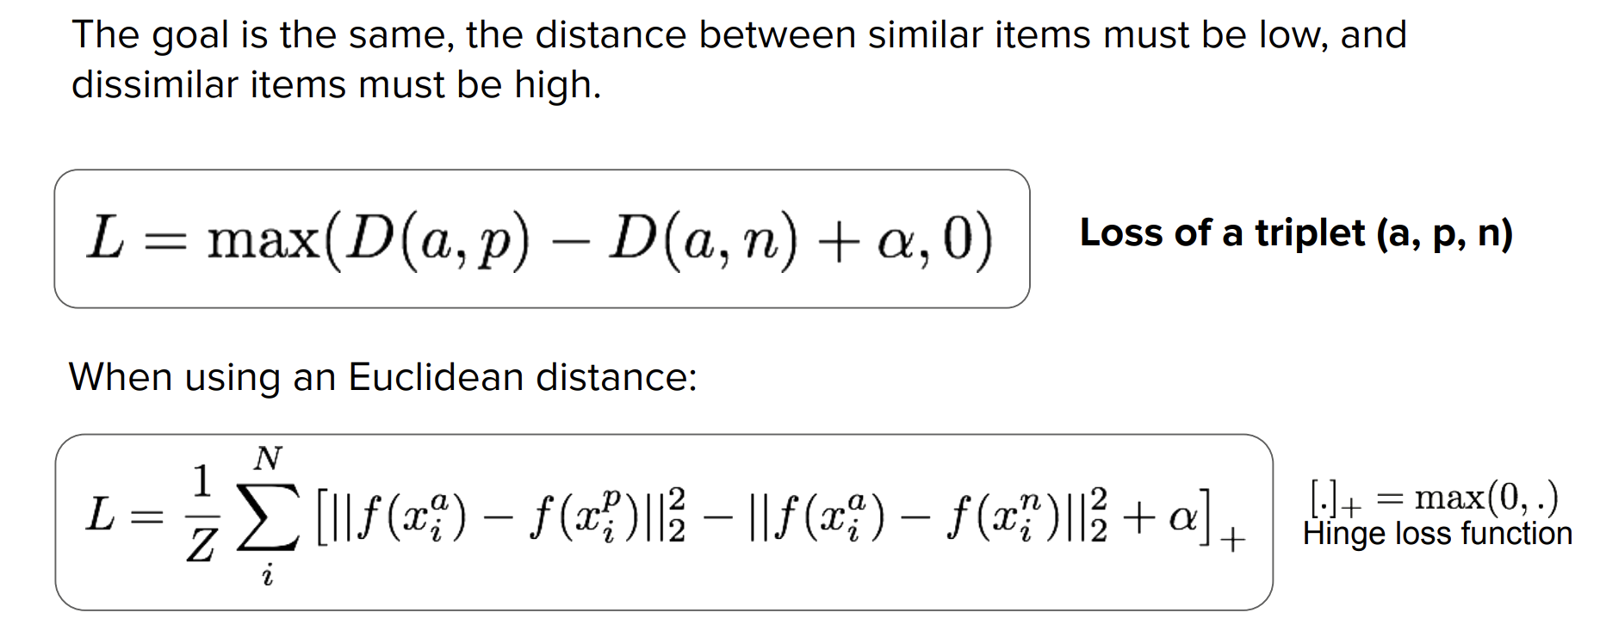
Triplet Loss

Slide 32
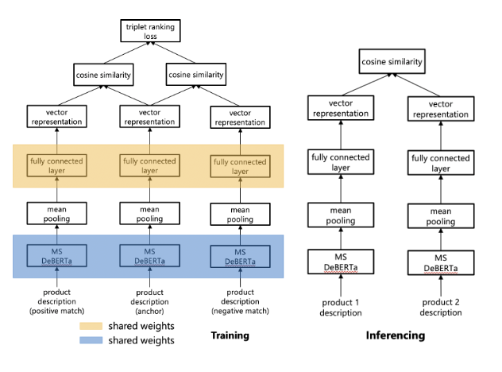
Deep Siamese Network
Training:
Inference:

Slide 33
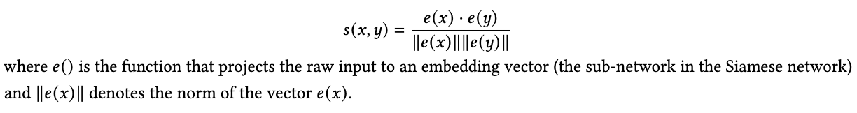
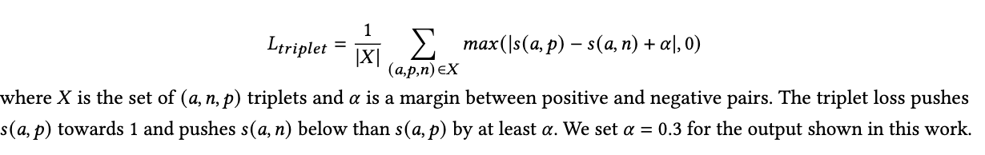
Deep Siamese Network
Similarity function:
Cost function:

Slide 34
Deep Siamese Network
Demo

Slide 35

Let’s work on the hands on examples now!!

